Slide 1
May 2021

Slide 2
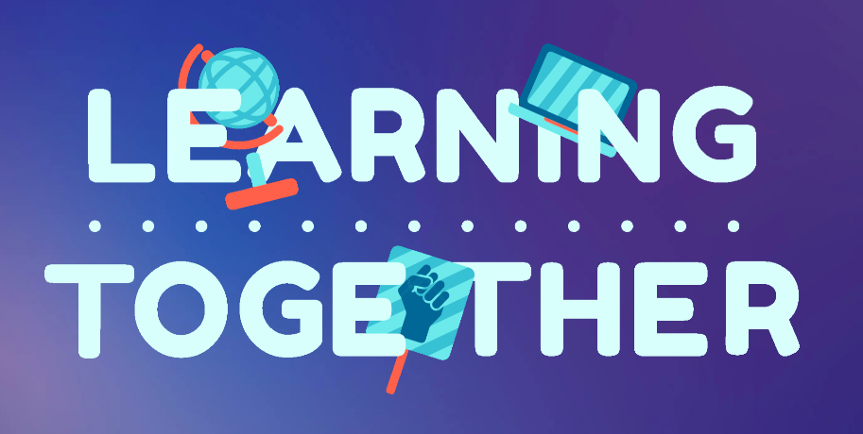
Notes:
In 2019, the Smithsonian partnered with Asian Pacific American educators and community members to create the Smithsonian Asian Pacific American’s Learning Together Center. This site curates art, music, films, poems, literature, discussion prompts, and resources to respond to Anti-Asian hate for students, educators, and lifelong learners everywhere

Slide 3
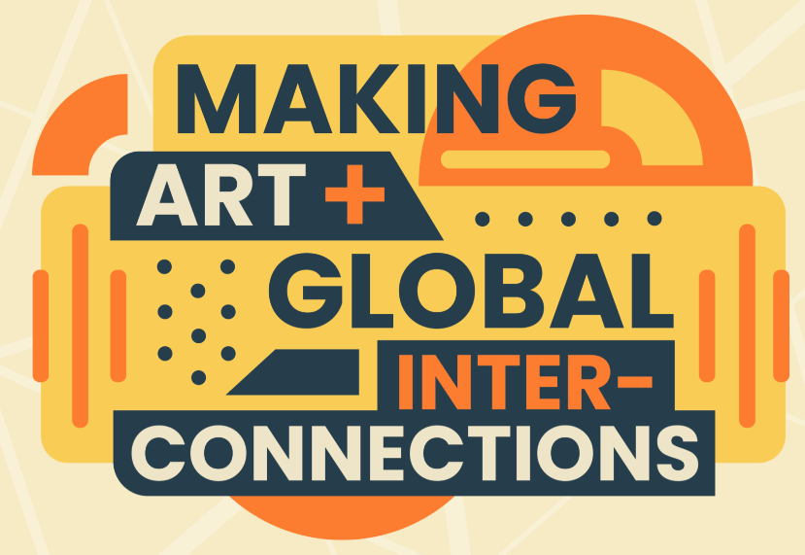
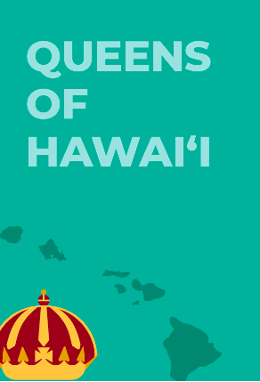
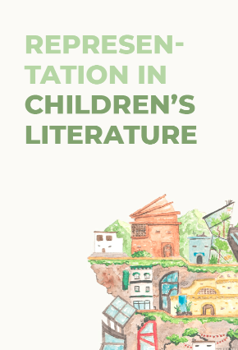
Notes:
During the month of May, staff across our campuses will be engaging students in learning through one of the many available modules which include social studies lessons, arts integration, representative children's literature, diasporic poets of the APA LGBTA+ community, and counternarrative storytelling.

